Slide 1
ENSC 427: COMMUNICATION NETWORKS SPRING 2023 FINAL PROJECT PRESENTATION Investigation into Wireless Device Botnets https://www.sfu.ca/~jaforres/ Jacob Forrest – 301360304 – jaforres@sfu.ca Boris Perdija – 301339378 - bperdija@sfu.ca Group 01

Slide 2
Table of contents
01
Introduction
02
03
UDP Flood Attack
Botnet Detection
Definitions, Motivation,
Project Overview
04
05
06
Literature Review
Simulation
Discussion
1

Slide 3
01
Introduction
2

Slide 4
Definition of Botnets
What are bots?
“Bots are computers infected with malicious program(s) that cause them to operate against the owners’ intentions and without their knowledge” [1]
What are Botnets?
Botnets are networks of compromised devices, known as bots, controlled by a single attacking party.
The malware is aimed to infect as many computers as possible without the owners' consent or awareness.
Ultimately, botnet use compromised devices to perform a synchronized task.
[1] L. Wenke, Botnet detection : countering the largest security threat. Springer, 2008.
3

Slide 5
How do Botnets Infect you?
In order for your device to be connected to a botnet network, it needs to have been infected by malware.
This malware can be spread via:
Phishing Campaigns
Email Attachments
Malicious Links
False Software Updates
Infected downloads
Pop ups
Social Engineering attacks
Bad-USB drops (rubber duckies)
4

Slide 6
What can Botnets do?
Botnets are a serious concern for cyber security.
Botnets are used for:
Phishing attacks
Distributed Denial of Service (DDoS) Attacks
Financial Breaches
Crypto jacking
Credential harvesting
Targeted Intrusions
Remote Desktop Protocol (RDP) Attacks
Botnets can cause serious disruptions to businesses, lost financial income, compromised user information, and much more.
5

Slide 7
Motivation: Mirai Botnet
The Mirai Botnet is designed to infect vulnerable IoT devices, such as smart home devices, cameras, and other wireless devices.
Mirai was able to infect a large number of devices due to the widespread use of default login credentials and the lack of security updates for many IoT devices.
In 2016, the Mirai Botnet was responsible for the largest DDoS attack in history, which targeted the DNS provider Dyn and caused major disruptions to internet services.
6

Slide 8
Project Overview
Simulation of a botnet consisting of IoT devices connected to wireless networks executing a DDoS attack with ns-3
Exploring the impact to a regular user’s TCP connection with the victim node
Varied number of bots
Measuring: TCP congestion window size, TX & RX bitrate, mean packet delay, packet loss ratio
Implementing a botnet traffic detection algorithm
We did not achieve this milestone
7

Slide 9
02
UDP Flood Attack
8

Slide 10
UDP Flood DDoS Attack
A type of DDoS attack that targets network protocols using UDP.
Overwhelms the target server or network with a flood of UDP packets.
UDP is a connectionless protocol, allowing attackers to send a large number of packets to random ports.
Difficult to detect and mitigate due to the use of legitimate traffic and distributed sources.
Mitigation strategies include rate-limiting UDP traffic, filtering suspicious traffic, and using DDoS protection services.
9

Slide 11
03
Botnet Detection
10

Slide 12
Detection
Botnets, while dangerous, are detectable.
Some current methods for botnet detection include:
Examine traffic content for IRC commands
Monitor DNS for strange usage
Set up honeynets to capture live bots
Analyze behaviours and signatures
Machine Learning algorithms
Many botnets use communication protocols such as IRC to send commands to infected devices. Hence, detection systems can look at chat sessions to examine content for botnet commands
DNS queries can be analyzed to identify the domains that the botnet is communicating and revealing potential C&C servers or botnet-infrastructure-related activities.
Honey nets are computer systems that are set up to trap or gain information. By deploying honeynets, defenders can capture live bots and analyze their tactics, techniques, and procedures.
Botnets often have a unique behavior pattern (attacking only at a certain time of day), or have a unique code signature that identify them
11

Slide 13
04
Literature Review
12

Slide 14
A review on Detection
“An empirical comparison of botnet detection methods”, by S. García, M. Grill , J. Stiborek , A. Zunino. Written 2014.
Botnet detection methods are hard to quantify and rank on their effectiveness.
Some reasons for being difficult to compare detection methods include:
Poor documentation between detection methods
Lack of a common botnet dataset
Lack of any uniform botnet comparison methodology
Lack of suitable error metric
The goal of this paper was to compare three botnet detection methods with reproducible methodologies, a good dataset, and a new error metric.
13

Slide 15
A review on Detection
Botnet detection methods looked at:
The CAMNEP Detection Method
“Cooperative Adaptive Mechanism for Network Protection (CAMNEP) is a Network Behavior Analysis system that consists of various state-of-the-art anomaly detection methods.”
Conclusion: Large false positives, and large true positives
The BClus Detection Method
“ Bclus method is a behavioral-based botnet detection approach. It creates models of known botnet behavior and uses them to detect similar traffic on the network.”
Conclusion: Low false positives, and low true positives
The BotHunter Method
“ The BotHunter method was proposed by Gu et al. (2007) to detect the infection and coordination dialog of botnets by matching a state-based infection sequence model.”
14

Slide 16
A review on Detection
“Comparing methods indeed helps to better estimate how good the methods are, to improve the algorithms, to build better datasets and to build a comparison methodology”
15

Slide 17
05
Simulation
16

Slide 18
Simulation Scenario
Main goal
Explore the impact of a DDoS attack that is launched from a botnet consisting of many devices connected to wireless networks
Implement a botnet detection algorithm
The ns-3 network simulator was used to simulate a DDoS attack on a single target node
Botnet nodes were connected to Wi-Fi networks
Botnet nodes generated traffic to the victim with UDP packets
A single legitimate user competed for bandwidth to the victim node
The legitimate user generated traffic via TCP connection
17

Slide 19
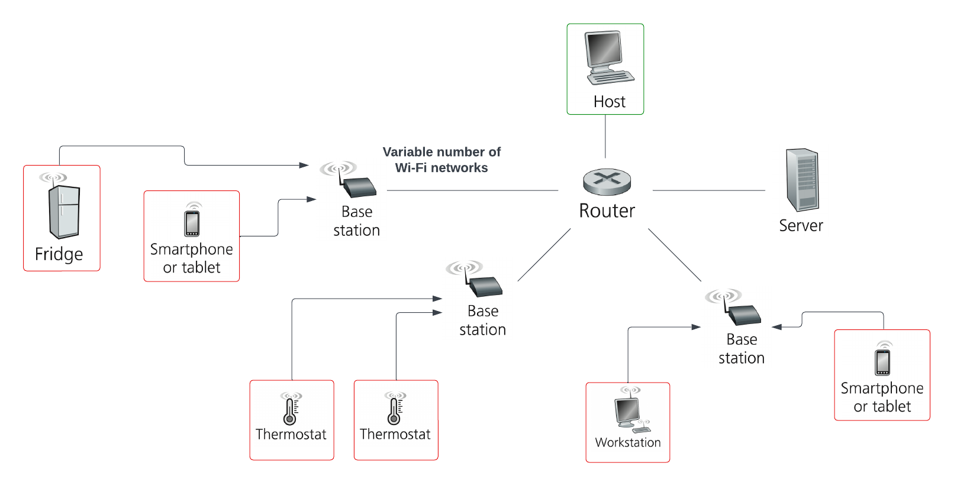
Network Topologies
18

Slide 20
Network Topologies
Simulations were conducted with a varying number of infected Wi-Fi networks.
[0, 2, 4, 5, 6, 8]
Each infected Wi-Fi network consisted of two botnet nodes
19

Slide 21
Network Topologies
All point-to-point links had bandwidth of 100 Mbps and a delay of 2ms
Drop Tail Queue = 100 packets
Channel error rate model = 0.0001
TCP application (legit user)
Packet Size: 1024 Bytes
Data Rate: 100 Mbps
UDP application (bot nodes):
Packet Size: 1024 Bytes
Constant bit rate: 10 Mbps
20

Slide 22
Results
21

Slide 23
Results
22

Slide 24
Results
23

Slide 25
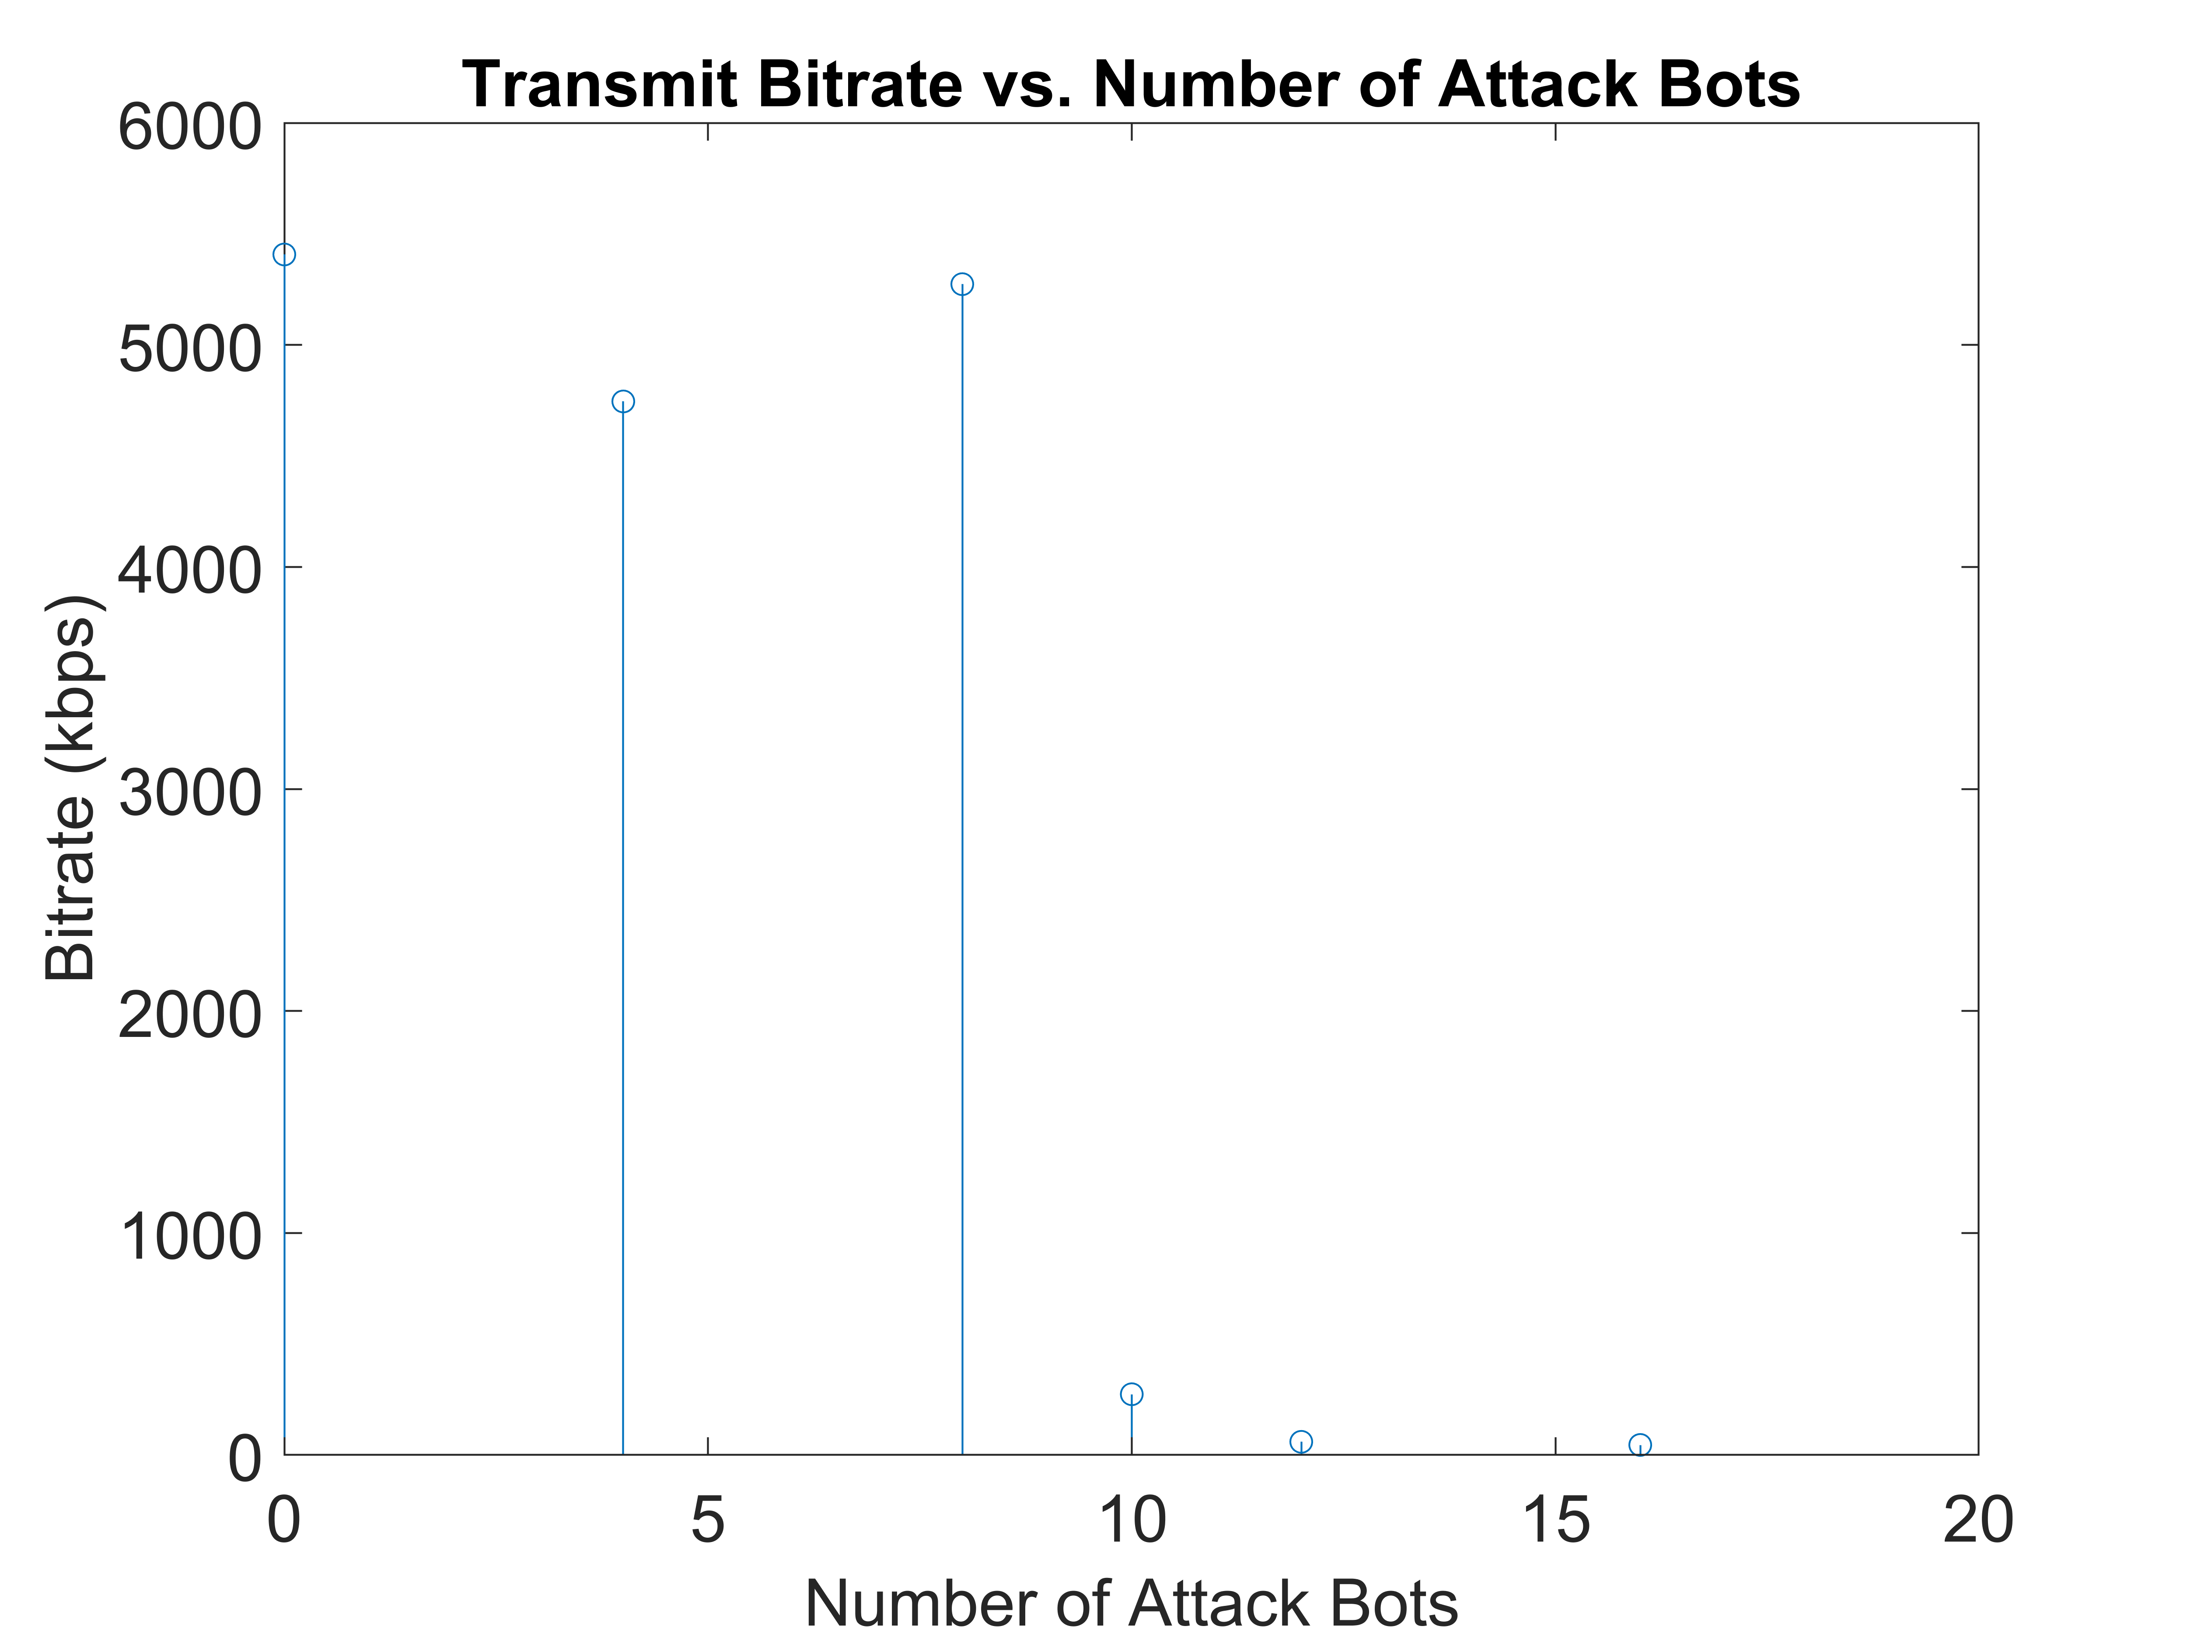
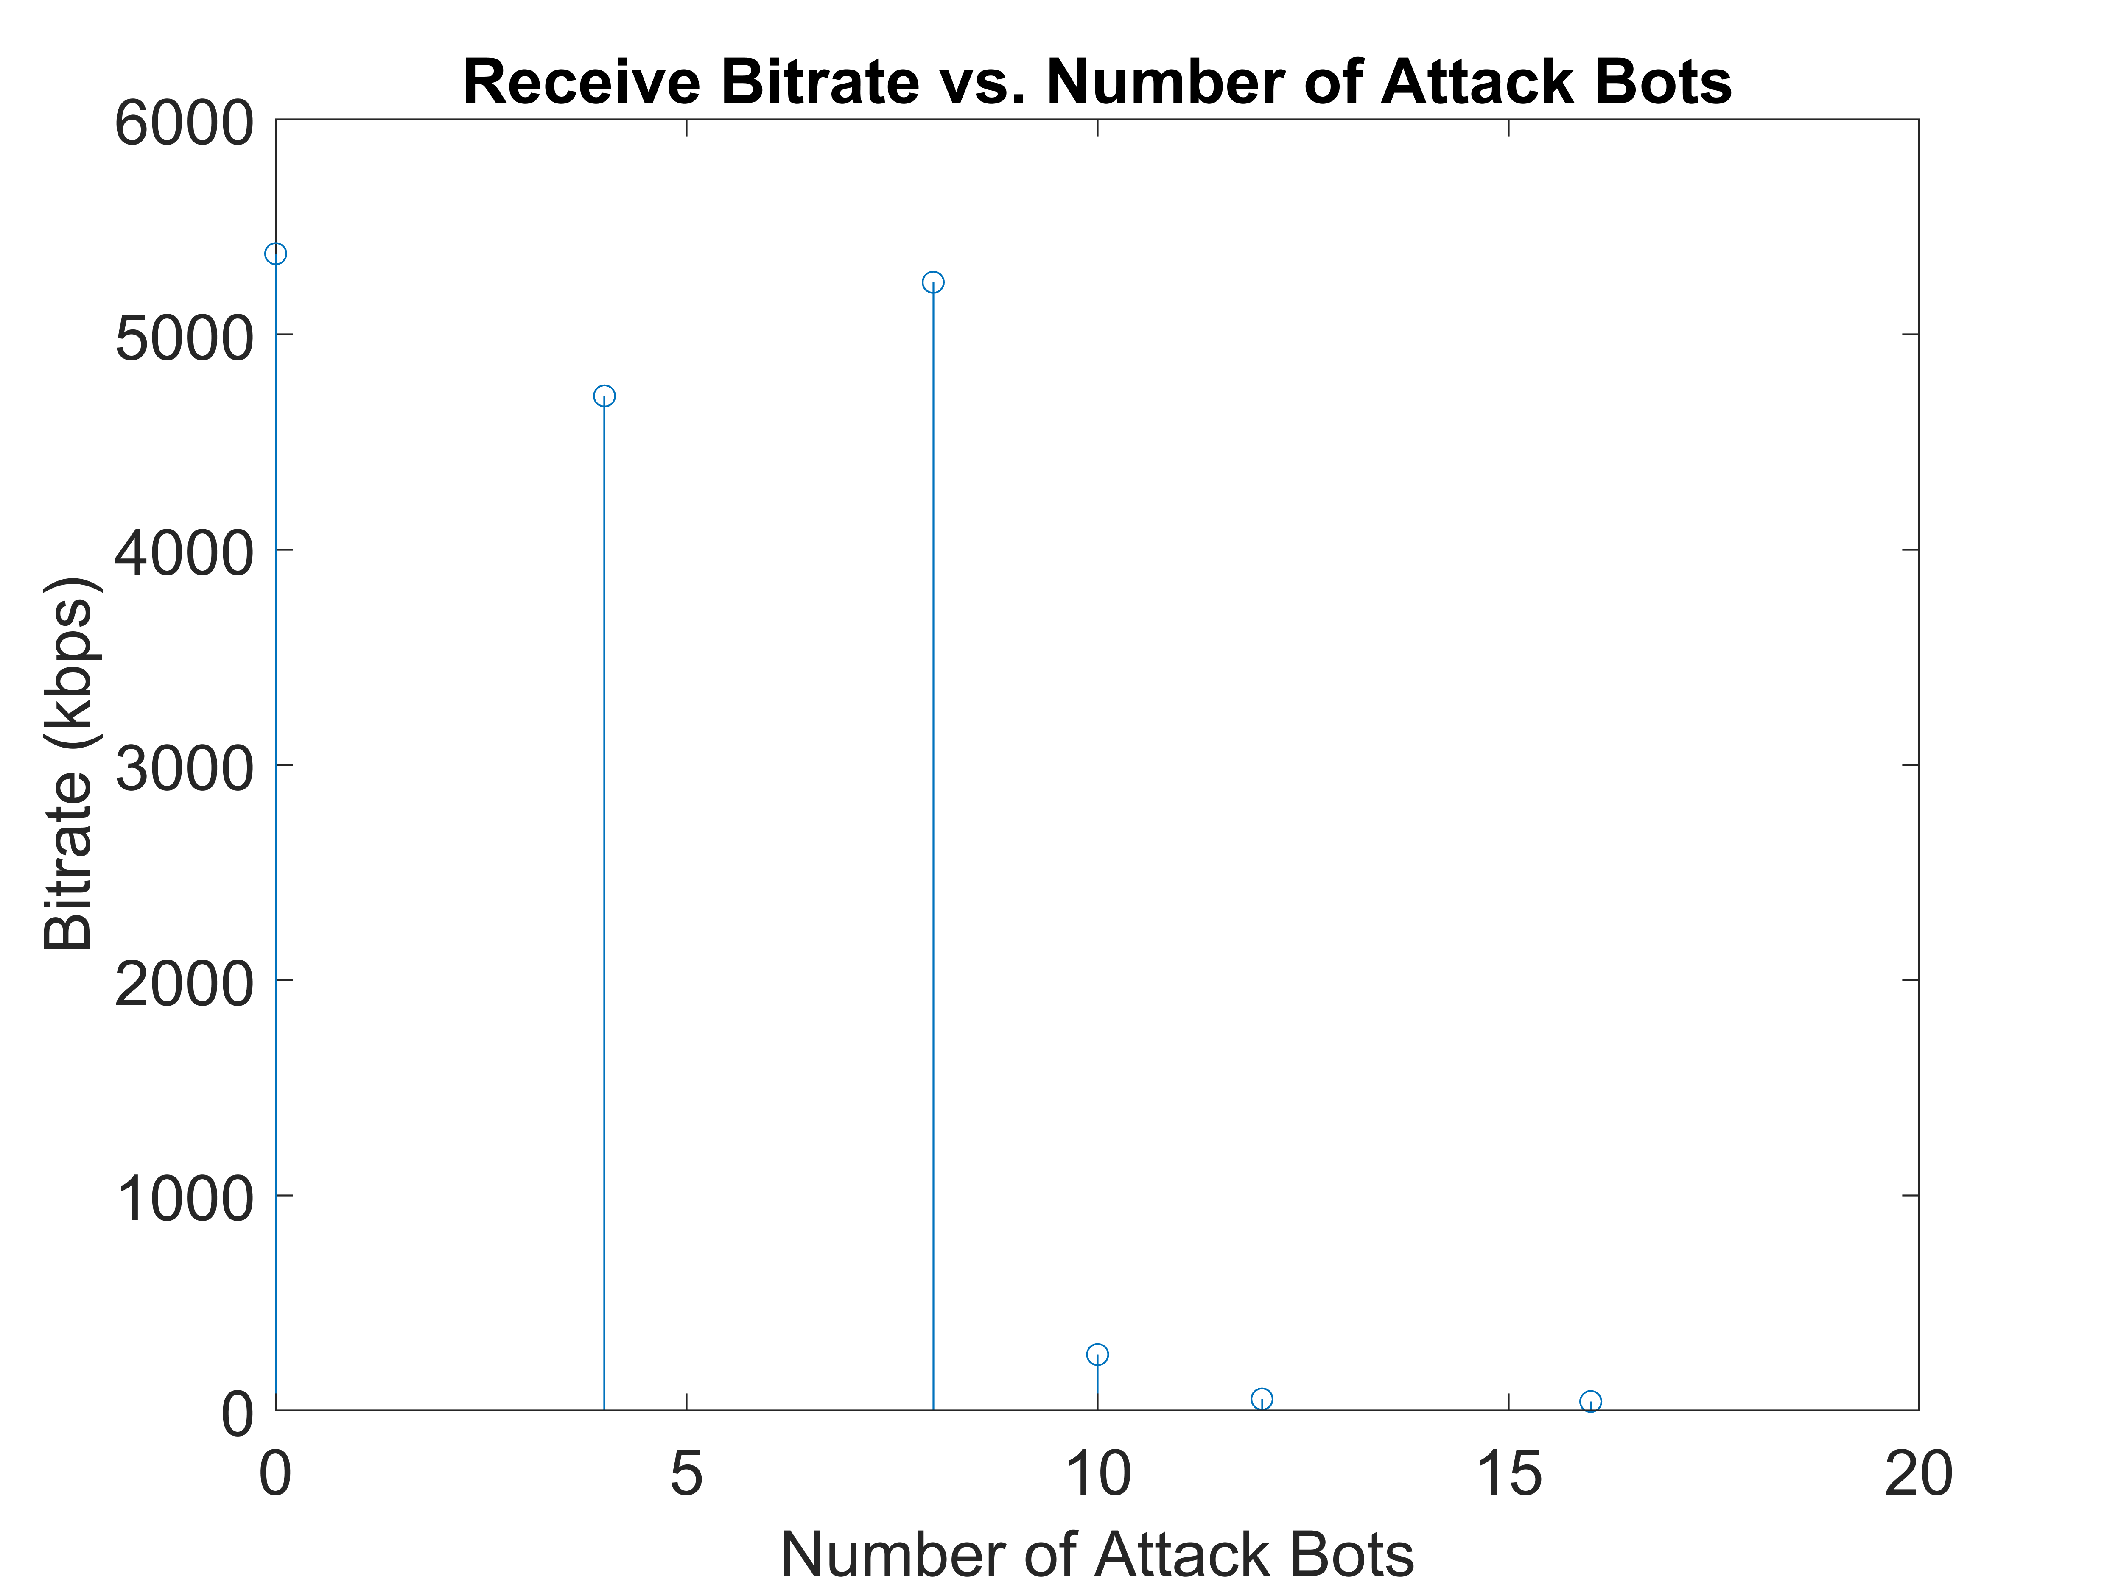
Results
24

Slide 26
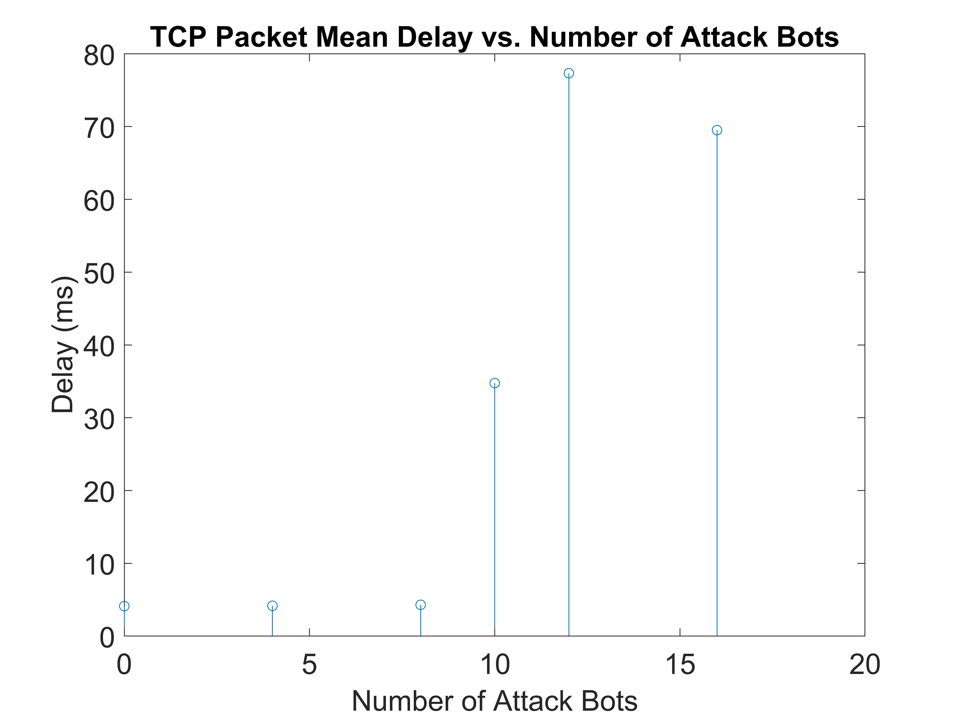
Results
25

Slide 27
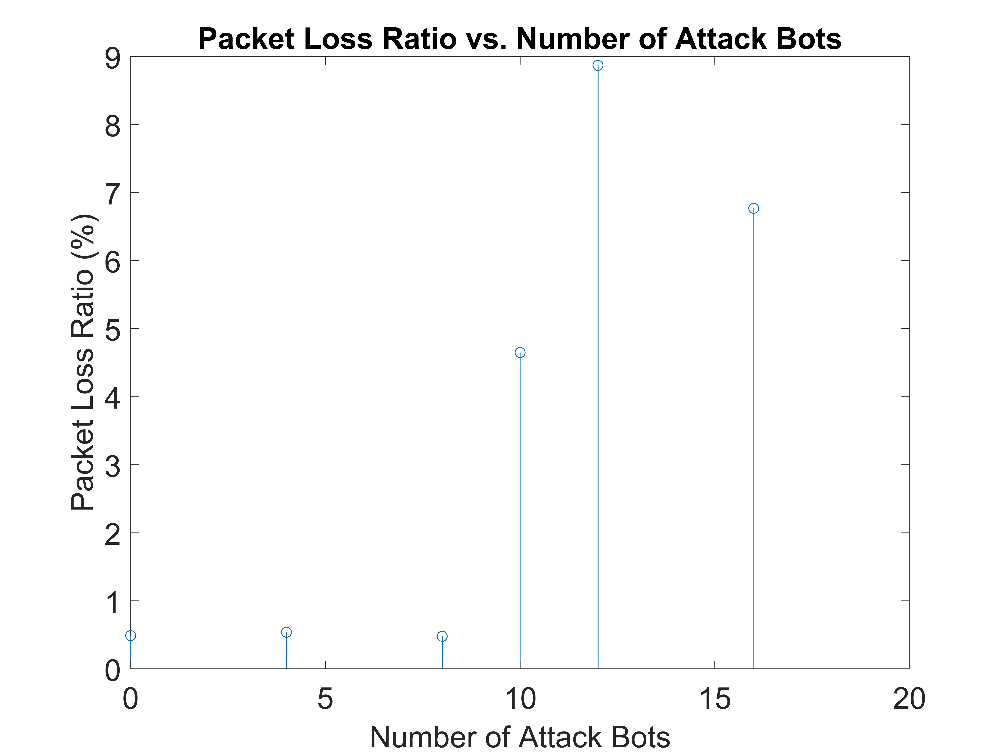
Results
26

Slide 28
06
Discussion
27

Slide 29
Discussion of Results
Zero Bots:
TX bitrate: 5407.28 kbit/s
RX bitrate: 5374.76 kbit/s
Mean Delay: 4.12 ms
Packet Loss Ratio: 0.49 %
Eight Bots:
TX bitrate: 5273.58 kbit/s
RX bitrate: 5242.14 kbit/s
Mean Delay: 4.30 ms
Packet Loss Ratio: 0.48 %
Twelve Bots:
TX bitrate: 59.38 kbit/s
RX bitrate: 53.89 kbit/s
Mean Delay: 77.32 ms
Packet Loss Ratio: 8.87 %
Four Bots:
TX bitrate: 4745.33 kbit/s
RX bitrate: 4714.12 kbit/s
Mean Delay: 4.17 ms
Packet Loss Ratio: 0.54 %
Ten Bots
TX bitrate: 273.72 kbit/s
RX bitrate: 260.58 kbit/s
Mean Delay: 34.76 ms
Packet Loss Ratio: 4.65 %
Sixteen Bots:
TX bitrate: 45.28 kbit/s
RX bitrate: 42.28 kbit/s
Mean Delay: 69.50 ms
Packet Loss Ratio: 6.77 %
As the network traffic increases with the addition of bot nodes, network performance degrades significantly.
Effective DDoS mitigation strategies, such as traffic filtering, firewalls, and intrusion detection systems, should be implemented to protect against such attacks.
28

Slide 30
Future Improvements
Implement a botnet traffic detection algorithm
Add legitimate user background traffic to each infected Wi-Fi network
Allow a variable number of bot devices on each Wi-Fi network
Implement botnet devices on other wireless technologies
LoRaWAN
ZigBee
29

Slide 31
Conclusion
Botnets are a series of bot computers that are under the control of an attacking party.
The Internet of Things (IoT) has provided a growing number of vulnerable devices for Botnet networks.
Botnets can be used for Distributed Denial of Service (DDoS) Attacks, Financial Breaches, Targeted Intrusions, and more.
Our ns-3 simulation showcased how a botnet consisting of wireless devices can be flood a network with UDP packets to significantly reduce the bandwidth available to legitimate users.
30

Slide 32
Prevention
Change default credentials
Disable unnecessary services
IoT devices often ship with the same credentials
Services such as remote access can create vulnerabilities
Keep devices up to date
Train yourself!
Prevents attackers from using open vulnerabilities
Monitor your network, know how to detect malware
31

Slide 33
References
L. Wenke, Botnet detection : countering the largest security threat. Springer, 2008.
Chen, R., Niu, W., Zhang, X., Zhuo, Z., & Lv, F. (2017). An effective conversation-based botnet detection method. Mathematical Problems in Engineering, 2017 doi:https://doi.org/10.1155/2017/4934082
N. Chavan, M. Kukreja, G. Jagwani, N. Nishad and N. Deb, "DDoS Attack Detection and Botnet Prevention using Machine Learning," 2022 8th International Conference on Advanced Computing and Communication Systems (ICACCS), Coimbatore, India, 2022, pp. 1159-1163, doi: 10.1109/ICACCS54159.2022.9785247.
García, Sebastián & Grill, Martin & Stiborek, Jan & Zunino, Alejandro. (2014). An Empirical Comparison of Botnet Detection Methods. Computers & Security. 45. 100-123. 10.1016/j.cose.2014.05.011.
32

Slide 34
Contributions
Jacob
ns3
Network Topology
Legitimate User TCP Application
TCP Congestion Window Tracing
Flow Monitor Tracing
Simulation Scenarios
Data Analysis & Graphing
Boris
ns3
Botnet UDP Application
Data Collection
Literature review
33

